Slide 1
Overview of computational thinking

Slide 2
Extended steps
Problem Analysis (from ill-defined to well-defined)
Decomposition
Pattern Recognition & Abstraction
Algorithm Design
Representation (e.g. pseudo code, flowchart)
Implementation / Simulation
Evaluation & Reflection

Slide 3
Step 01: Problem analysis

Slide 4
Elements of a well-defined problem
Input / Initial states
Output / Goal states
Operators: process or transformation
Evaluation function: how to define good?
Constraints
Technically executable (feasible)
Notes:
2.1. Xác định rõ Initial State (Trạng thái ban đầu): Có đủ dữ liệu, thông tin để bắt đầu? Nếu không, bạn cần định nghĩa rõ hơn.
2.2. Xác định rõ Goal State (Mục tiêu) Mục tiêu mong muốn là gì? Là output cụ thể hay chỉ mong muốn chung chung? Ví dụ: "tối ưu chi phí" cụ thể là "chi phí phải dưới X"?
2.3. Xác định Operators (Phép biến đổi) Bạn cần biết rõ cách xử lý hoặc phép toán nào sẽ chuyển từ input đến output.
2.4. Xác định Evaluation Function (Hàm đánh giá) Làm thế nào để biết kết quả là “đúng” hay “tốt”? Cần một tiêu chí đánh giá cụ thể.
2.5. Thêm Constraints (Ràng buộc, giới hạn) Các ràng buộc giúp thu hẹp không gian giải pháp và định hướng rõ hơn. Ví dụ: thời gian thực thi, tài nguyên, định dạng dữ liệu…
2.6: Khả thi về mặt kĩ thuật

Slide 5
Example: Escape room challenge
Input: Questions to solve
Output: Key combination to unlock
Operators: Using hint to create an answer, then use the answer to create a number
Evaluation: Escape the room successfully within time limit
Constraints: Questions should not too easy or too hard
Technically executable: yes (on paper, simple lock)

Slide 6
Examples of ill-defined problems
“How to help students learn better?”
“Create an optimal travel plan”
“Create a food recommendation system”
“Create an attendance system”
Why are these problems ill-defined?

Slide 7
Problem analysis tools
Clarification questions
Stakeholder mapping
Requirements elicitation
Constraint specification
Use case / Epic & User stories
Formalization

Slide 8
Tool 01: Clarification questions
Problem analysis tools

Slide 9
Objectives of the questions
The real goals of the problem
Specific input & output
Constraints, limitations and boundaries
User expectation
Finding the root cause

Slide 10
Activity - Clarification questions
What questions could help you clarify and solve the problem?

Slide 11
1. Goal Clarification
Food recommendation system
“What are we trying to achieve?”
Final goal?
Help users choose quickly or eating more healthier?
How to measure success?
User’s satisfaction?
Who is going to use this system?
Normal user? Restaurant’s owner?

Slide 12
2. Input / Output Clarification
Food recommendation system
“What is the input?”
User’s information / history / hobbies
“Expected output?”
List of food / daily menu
“Where can we get the data?”
Manually / Database / Learn on the fly

Slide 13
3. Constraints & Scope
Food recommendation system
“What are the resources’ constraints?”
Run on web or mobile?
“Scope of the application?”
World-wide support or Vietnam only?
“Ethics or Religions concerned?”
Vegetarian? Allergy?

Slide 14
4. Assumption Checking
Food recommendation system
“Are you sure the user want the system to choose food rather than manually selected?”
“Cold start problem: How can the system suggest for new user without previous data?”

Slide 15
5. Root-Cause Clarification
Food recommendation system
“What is the root cause? Bad UI design or user cannot make a choice?”
“Why is this important? Does it really improve user experience when ordering?”

Slide 16
Effective questioning techniques
5 Whys (Toyota)
Socratic Questioning: proof? other pov?
Reframing Question: look from another pov
What / How / Why Model
User Journey / Scenario-based
Boundary Questions

Slide 17
Questions template
1️⃣ Goal:
What problem am I trying to solve?
Why is this problem important?
2️⃣ Users / Target Audience:
Who are the main users?
What specific difficulties do they face?
3️⃣ Inputs – Outputs:
What data do I need?
What is the expected outcome?
4️⃣ Constraints:
Are there any limitations in time, technology, or budget?
5️⃣ Assumptions & Risks:
What assumptions am I making?
What could go wrong?
6️⃣ Success Criteria:
How will I know the problem has been successfully solved?

Slide 18
Activity - Practicing questioning
“Create an optimal travel plan recommendation”
“Create an attendance system for the class”
“Create a smart parking system”

Slide 19
Tool 02: Stakeholder mapping
Problem analysis tools

Slide 20
Stakeholder
Person / group / organization
Has an interest in or
Is affected
By a project, product, or decision

Slide 21
Example - Smart parking system
Users: drivers who use the app to find parking.
Operators: parking lot owners or attendants.
Developers: the team building and maintaining the system
City authorities: they care about traffic flow and regulations
Investors: they want financial returns

Slide 22
Priority (Highest to lowest)
Manage Closely: Owners
Keep Informed: Users, operators
Keep Satisfied: Investors
Monitor: Authorities

Slide 23
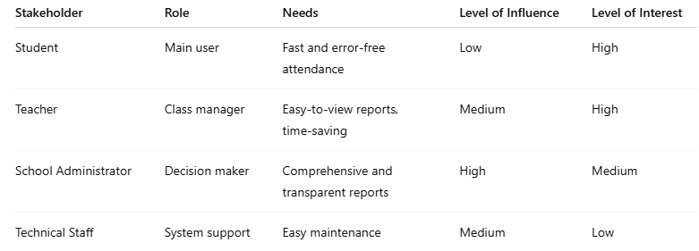
Stakeholder mapping - Attendance

Slide 24
Tool 03: Requirements elicitation
Problem analysis tools

Slide 25
What is requirement elicitation?
Gathering and understanding what users and stakeholders need from a system or product

Slide 26
Types of requirements
Functional
Non-functional

Slide 27
Common techniques
Interviews: talking directly with users or stakeholders
Surveys / Questionnaires: collecting opinions or needs
Observation: watching users do their work to understand real-world challenges
Workshops / Brainstorming: gathering ideas in group sessions
Use cases / User stories: describing how the system will be used
Document analysis: reviewing existing systems / reports / manuals
Prototyping: showing mockups or early versions to get feedback

Slide 28
Tool 04: Constraint specification
Problem analysis tools

Slide 29
What is constraint specification?
Limitations or restrictions

Slide 30
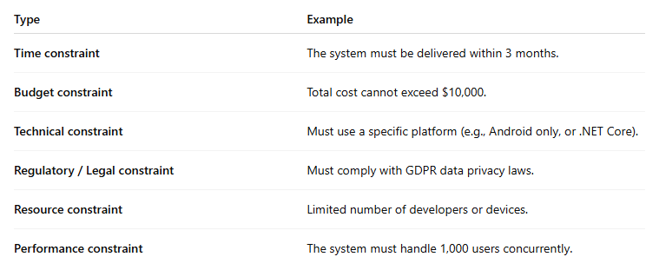
Example types of constraints

Slide 31
Tool 05.1: Use case
Problem analysis tools

Slide 32
What is a use case?
How a user interacts with a system to achieve a particular goal

Slide 33
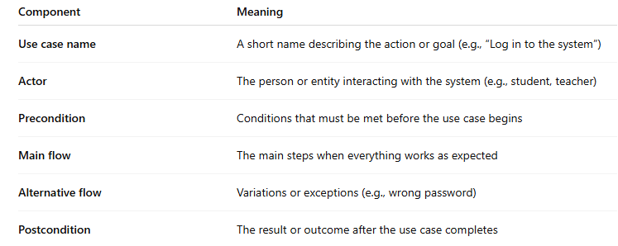
Components of a use case

Slide 34
Example - Attendance System
Use Case: “Take attendance”
Actor: Teacher
Goal: Record the presence of students during class.
Precondition: The teacher has logged into the system.
Main flow:
- The teacher selects a class.
- The system displays a list of students.
- The teacher marks each student as present or absent.
- The system saves the attendance record.
Postcondition: The attendance list is successfully saved.
Alternative flow: If the network fails → The system displays “Unable to save, please try again.”

Slide 35
Example - Learning Path Recommendation System
Use Case: “View suggested learning path”
Actor: Student
Goal: View learning courses that match the student’s current ability.
Precondition: The student has entered their grades or learning results.
Main flow:
- The student logs in.
- The student selects “View learning path.”
- The system analyzes the student’s ability and shows recommended paths.
- Postcondition: The suggested learning path is displayed.
Alternative flow: If no grade data exists → The system prompts the student to enter their grades first.

Slide 36
Tool 05.2: Epic & User story
Problem analysis tools

Slide 37
What is epic?
“Who are the users?” (stakeholder)
“What problem are they having?” (context)
“What is the success criteria?” (evaluation criteria)
“What are the constraints?”
Epic example: “As a student, I want the system to suggest a suitable learning path so that I can study more effectively”

Slide 38
User story: more detailed epic
User Story 1: “As a student, I want to enter my grades so that the system can understand my current ability.”
User Story 2: “As a student, I want to view a learning progress chart so that I can see where I currently stand.”

Slide 39
Tool 06: Formalization
Problem analysis tools

Slide 40
Traveling Salesman Problem
“I want to find the shortest way for a delivery driver to visit all destinations and return to the starting point.”
Key elements
Locations = nodes (A, B, C, D, …)
Roads between them = edges
Distance/time = weight on each edge
Model this as a graph:
G = (V, E)
V: set of vertices (locations)
E: set of edges (roads), each with a weight w(e) distance

Slide 41
Sorting problem
“Sort these student names alphabetically”
Given a list L = [n₁, n₂,..., n_{k}]
Reorder it such that n_{i} <= n_{i+1} for all i

Slide 42
Ill-defined to well-defined continuum

Slide 43
Well-defined (Highest to lowest)
One single solution
One strategy, multiple implementations: The idea and approach are clear, but there are several possible concrete implementations.
Several typical strategies, each with multiple implementations: Still within the well-defined category, but with a slight degree of diversity
Multiple open-ended strategies that can still be automatically verified as correct/incorrect: The solutions can be very diverse, yet can still be evaluated based on clear criteria.
Cannot automatically verify the correctness of the solution: Highly ill-defined, requiring subjective evaluation and lacking clear criteria

Slide 44
Example
Listen to music:
Multiple strategies: listen online, CD, Radio
Multiple solutions: multiple website
House to school
Multiple strategies: by bike, on foot, by car, by bus
Multiple solutions: multiple routes

Slide 45
Common problems in problem analysis

Slide 47
1. Misframing the Problem
Symptoms:
Jumping directly into the solution (UI, app, API) without analyzing the actual computational problem.
Describing the product, not the problem.
Incorrect example:
“We are building an app to recommend restaurants and optimize travel routes.”
➡ This is a product description, not a computational problem.
Fix: Rewrite as an actual CT problem:
“How do we rank N restaurants based on a user’s feature vector?”
“How do we find an ordering of points that minimizes total travel distance?”

Slide 48
2. Poor Decomposition
Symptoms:
Breaking the system by UI features rather than computational steps.
Mixing recommendation + routing + UX into one big blob.
Producing a long list of FR without logical grouping.
Incorrect example:
FR1: Find restaurants
FR2: View map
FR3: Find by budget
… ➡ This is feature listing, not CT decomposition.
Fix: Decompose by computational nature:
Module 1: Input representation
Module 2: Recommendation (ranking/scoring)
Module 3: Route optimization (TSP-light)
Module 4: Data transformation & filtering

Slide 49
3. Lack of Data Normalization
Symptoms: Using raw rating (1–5), price (20k–1M), distance (0–10km) directly in formulas.
Result:
One feature (e.g., price) dominates all others → wrong results.
Fix: Normalize all features to [0,1].

Slide 50
4. Data–Need Mismatch
Symptoms:
The problem requires feature vector X, but the dataset only contains Y.
Want “tourist trap detection” without local/foreign review data.
Want travel time without traffic information.
Result:
Wrong representation → wrong algorithm.
Fix: In Problem Analysis, list:
Required data
Available data
Missing data → workaround (simulate / API / assumptions)

Slide 51


5. Unclear Input–Output Specification
Symptoms:
No clear definition of what the system receives and returns.
Output described vaguely (“returns recommended places”).
Fix:
Input Output

Slide 52
6. Feature-driven, Not Computation-driven Analysis
Symptoms: Listing app features instead of computational components.
Incorrect example:
“The system allows filtering restaurants.”
Fix:
Describe computational behavior:
Filtering = O(N) scan
Distance = Haversine formula
Ranking = sort O(N log N)

Slide 53
7. Lack of Mathematical Representation
Symptoms:
No feature vectors
No scoring functions
No distance matrix
No graph model
Fix:
Recommendation → vector space
Routing → weighted graph
Reviews → statistical aggregation
Preferences → attribute → numeric score

Slide 54
8. Non-measurable Problem Definitions
Incorrect example:
“The system finds delicious restaurants.”
“Delicious” is subjective → cannot compute.
Fix: Define measurable criteria:
Rating ≥ 4.0
≥ 20 reviews
Tag match ≥ 0.5
Distance ≤ 3 km

Slide 55
9. Ignoring Constraints
Common forgotten constraints:
API quota
Rate limits
Dataset size
Algorithm complexity
Demo time
Device constraints
Incorrect example:
“We will implement Held–Karp to solve TSP.”
❌ Held–Karp is O(2^N) → impossible for N>12.
Fix:
Explicitly state constraints in Problem Analysis:
Choose Greedy + 2-opt instead.

Slide 56
10. Missing Edge Cases
Forgotten edge cases:
No restaurants match filters
All restaurants exceed budget
API failure
Missing fields
User selects too many places (TSP explosion)
Fix:
List edge cases in Problem Analysis.
Provide fallback strategies (e.g., sort by rating if tags missing).

Slide 57
11. No Evaluation Criteria
Symptoms:
“The system works well” but with no definition of “well”.
Fix: Define evaluation metrics:
Recommendation
precision@5 ≥ 80%
Routing
Total distance ≤ 1.3 × optimal
Performance
API latency p95 < 800ms

Slide 58
12. Mixing UX Issues with CT Problems
Symptoms:
Too much persona, journey map, UI description.
Too little computational analysis.
Fix:
Separate UX concerns.
CT Problem Analysis must focus on:
Feature extraction
Constraints
Data normalization
Algorithms
Input–output modeling

Slide 59
13. Missing In-scope / Out-of-scope Boundaries
Symptoms:
Problem analysis includes login, social features, payments, profiles…
Result:
The analysis becomes unfocused.
Fix: Define scope clearly:
In-scope: recommendation + route optimization
Out-of-scope: accounts, payments, social sharing

Slide 60
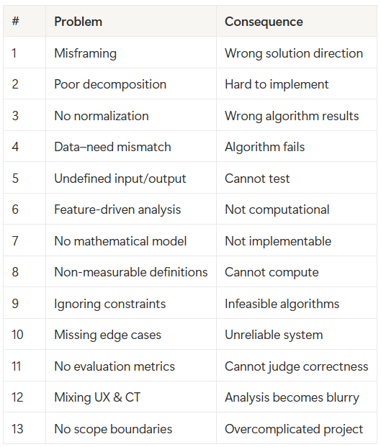
Summary

